Slide 1
Final Projection Presentation
Presented by Joseph Driscoll and Isaac Hill

Slide 2
Problem
Speed controlled by keypad
Steady state speed within 5% of desired speed
BCD stopwatch that displays times from 0.0 to 9.9 seconds controlled by the keypad
Closed loop response that settles in half the time it takes to settle with an open loop response
Overshoot less than 10%

Slide 3
Solution
We decided to use a PID controller.
The PID controller has three variables that can be altered to control overshoot and response time (?)
[More reasons we chose a PID controller]

Slide 4
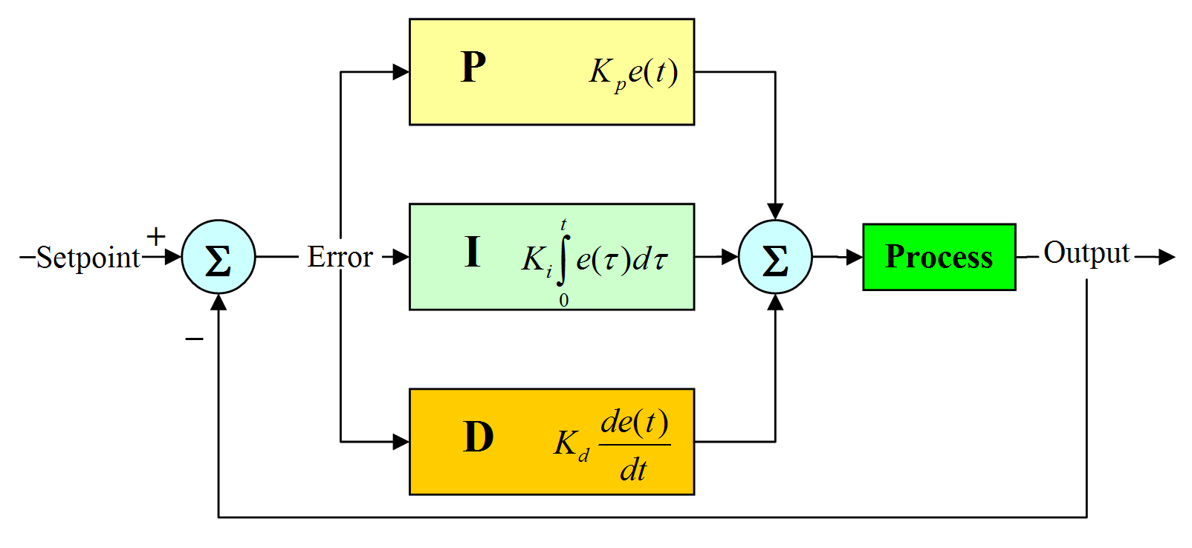
PID Controller
PID controller design:
proportional gain (K_{p}),
integral gain (K_{i}),
derivative gain (K_{d})
https://nicisdigital.wordpress.com/2011/06/27/proportional-integral-derivative-pid-controller/
The PID controller transfer function in the frequency domain is:
C(s) = K_{p} + K_{i}/s + K_{d}*s.

Slide 5
PID Controller Operation
Proportional gain – sensitivity to error
Integral gain – reduces set-point error
Derivative gain – improve settling time and stability

Slide 6
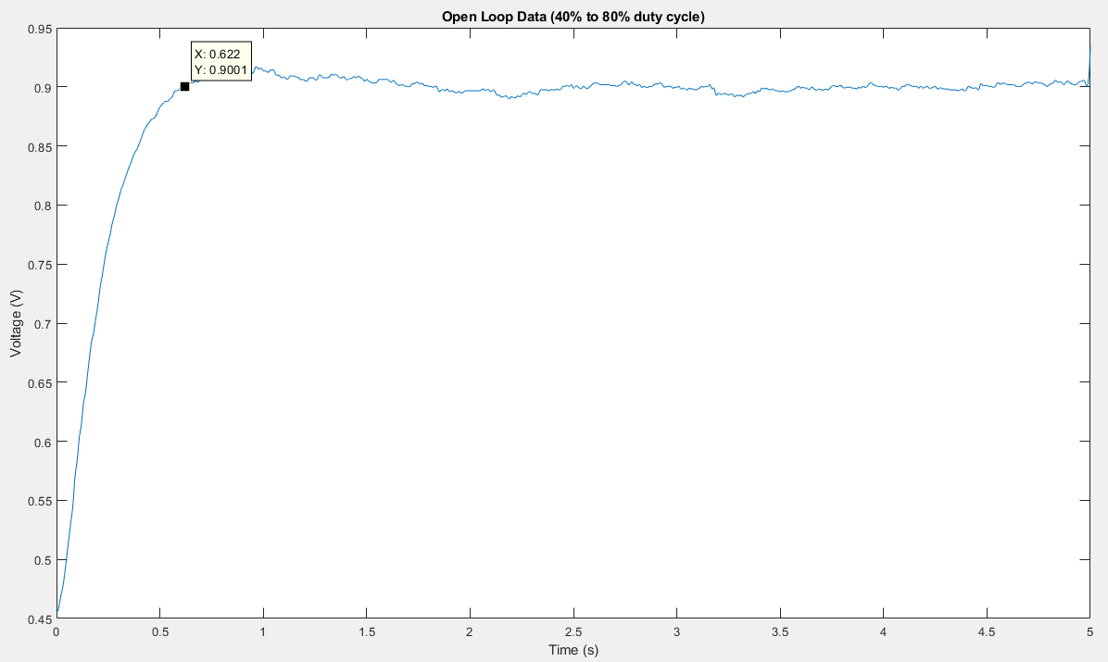
Open Loop Captured Data

Slide 7
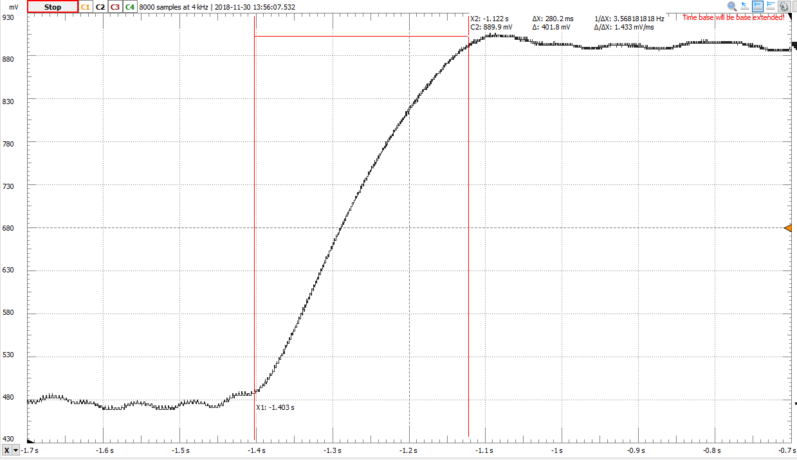

Slide 8
PID Response
Same transition from 480 mV to 900 mV
Settling time: 280-300 ms
Minimal ripple: under 10 mV

Slide 9
PID Program

